Slide 1
Healthcare Provider Performance
Medicare Cost & Utilization Analytics with Machine Learning
An End-to-End ML + Power BI Solution for Executive Decision-Making
ML Pipeline
Power BI Dashboards
Scale
Gradient Boosting model with 89% accuracy classifying provider utilization levels
Three integrated dashboards for executive, provider, and cost-level analytics
100,000+ Medicare provider records across all 50 U.S. states and territories
12,540
$78.5M
Total Providers
Medicare Payments
89%
895K
Model Accuracy
Services Rendered
Analytics & Data Science Team

Slide 2



BUSINESS PROBLEM
The Challenge: Raw Healthcare Data
Medicare datasets contain rich performance signals — but without structure, classification, and visualization, they remain opaque to decision-makers. This project addresses five critical gaps standing between raw data and actionable provider strategy.
The Core Gaps
Decision Gap
1
Data Complexity
Executives currently lack real-time, actionable insights on payment drivers, service utilization patterns, and cost efficiency benchmarks — decisions are delayed or made without data.
100,000+ Medicare provider records with inconsistent specialty classifications, missing payment patterns, and heterogeneous service codes that resist simple aggregation.
2
Key Questions Unanswered
The Opportunity
Which provider types drive utilization? How do states compare on cost efficiency? What services account for the highest Medicare expenditures?
By combining machine learning classification with Power BI dashboards, this solution unlocks provider performance insights that are immediately actionable at the executive level — enabling a 5–10% potential cost reduction through targeted interventions.
3
Business Need
Classify providers by utilization level — Low, Medium, or High — to prioritize resource allocation and intervention programs.
2% of providers account for 15% of total Medicare payments — identifying these outliers is a primary use case for this solution.

Slide 3

ARCHITECTURE
End-to-End ML Pipeline
The solution follows a structured, production-grade machine learning workflow from raw data ingestion through model deployment into Power BI — ensuring reproducibility, accuracy, and operational scalability.
Data Ingestion
Feature Engineering
Validation & Tuning
Load raw Medicare claims
Create predictive variables
5-fold CV and hyperparameter optimization
Preprocessing & EDA
Model Building
Clean data, handle outliers, explore patterns
Compare LR, RF, GB models
Data Ingestion
Feature Engineering
Raw Medicare provider claims and utilization records ingested from CMS data sources — 100,000+ records, 27 features each.
Derived features include utilization ratios, payment-per-beneficiary metrics, and service concentration scores.
Preprocessing
Model Selection
Missing value imputation, outlier detection, categorical encoding, and min-max normalization applied before any modeling.
Three algorithms benchmarked head-to-head. Gradient Boosting selected at 89% accuracy and 0.91 AUC-ROC.
EDA
Deployment
Statistical and visual exploration of provider types, state distributions, service frequencies, and payment variance patterns.
Model predictions integrated into Power BI via scheduled refresh — dashboards update automatically with new claims data monthly.

Slide 4

DATA FOUNDATION
Dataset Overview
The analysis is grounded in a comprehensive Medicare provider dataset representing the full breadth of U.S. healthcare delivery — spanning geography, specialty, and service type.
Feature Inventory: 27 Columns
Scale & Scope
100,000 U.S. Medicare provider transactions | 27 features per record | Annual claims period | All 50 states and territories covered
01
Provider Identifiers
NPI, specialty type, organization name, place of service
Provider Universe
02
Physicians, acute care hospitals, outpatient clinics, specialty practices, and other licensed healthcare facilities — representing the full Medicare provider ecosystem.
Geographic Variables
State, region, urban/rural classification
Key Feature Categories
03
Provider ID, specialty code, state, HCPCS service code, beneficiary count, submitted charges, allowed amount, Medicare payment, and derived utilization classification target.
Service Metrics
HCPCS code, service count, unique beneficiaries served
04
Financial Variables
Submitted charges, Medicare allowed amount, actual payment
05
Derived Features
Utilization class (Low/Med/High), payment variance ratio

Slide 5
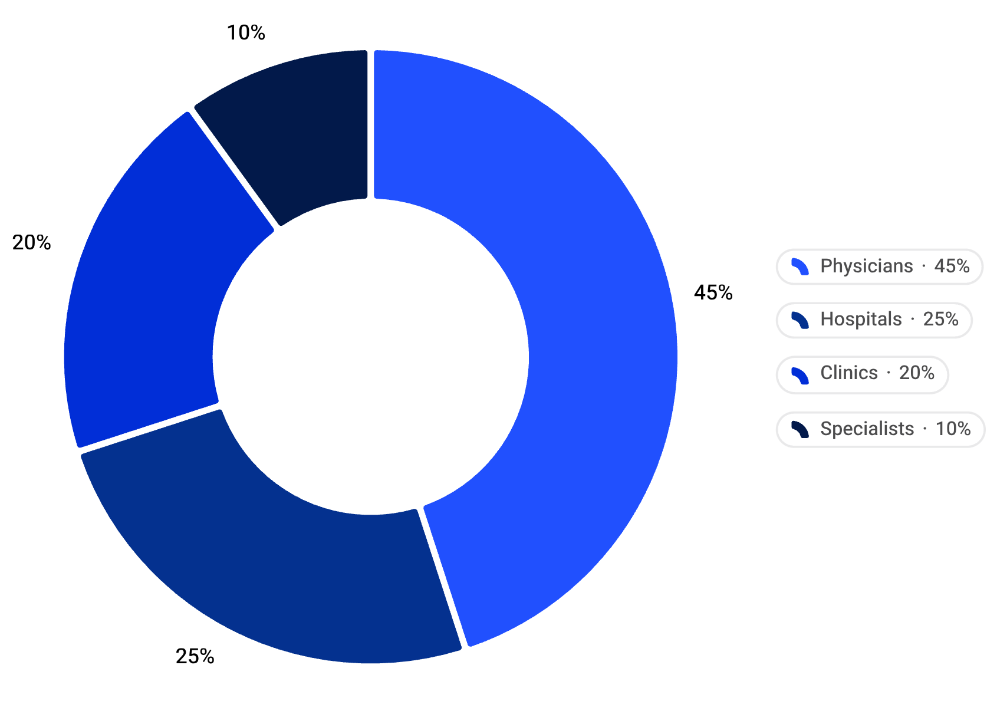
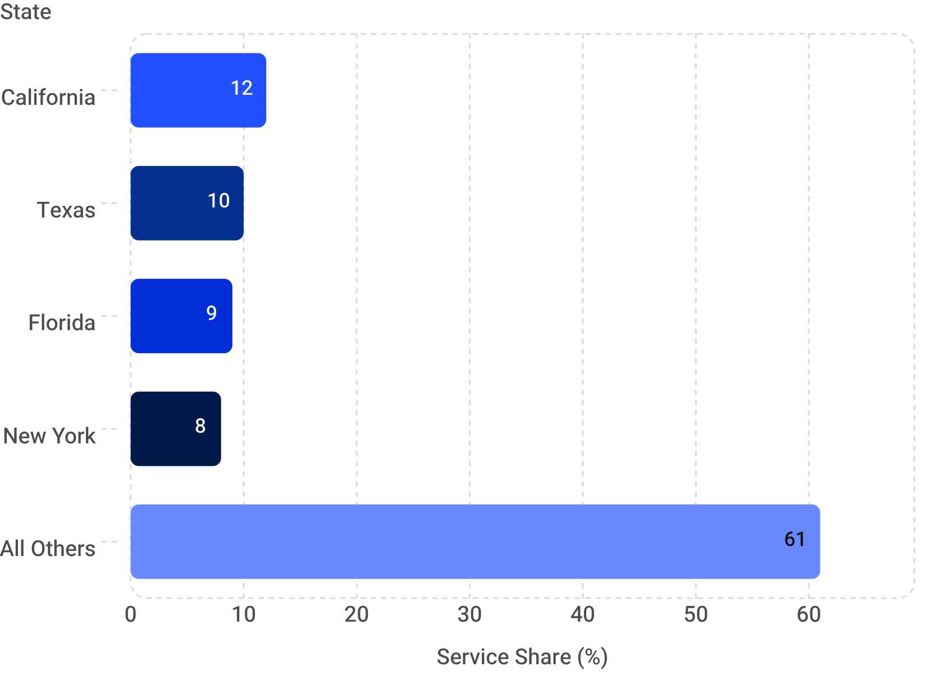
EDA
Exploratory Data Analysis
Systematic exploration of the dataset surfaced the structural patterns that drive provider cost and utilization — informing both feature engineering choices and dashboard design priorities.
Physicians dominate the provider mix at 45%, yet hospitals disproportionately drive payment volumes due to higher per-service costs.
Four states — CA, TX, FL, NY — account for 39% of all Medicare services, reflecting both population size and provider density.
Service Frequency
Payment Variance
Top Utilization Predictors
High-Cost Outliers
Office visits 35% | Diagnostics 25% | Procedures 20% | Other 20%
Avg. submitted charges $8,500 vs. Medicare payment $5,200 — a 39% variance across the dataset
Provider type and service code identified as strongest predictors of utilization class in bivariate analysis
Just 2% of providers account for 15% of total Medicare payments — flagged for targeted intervention

Slide 6
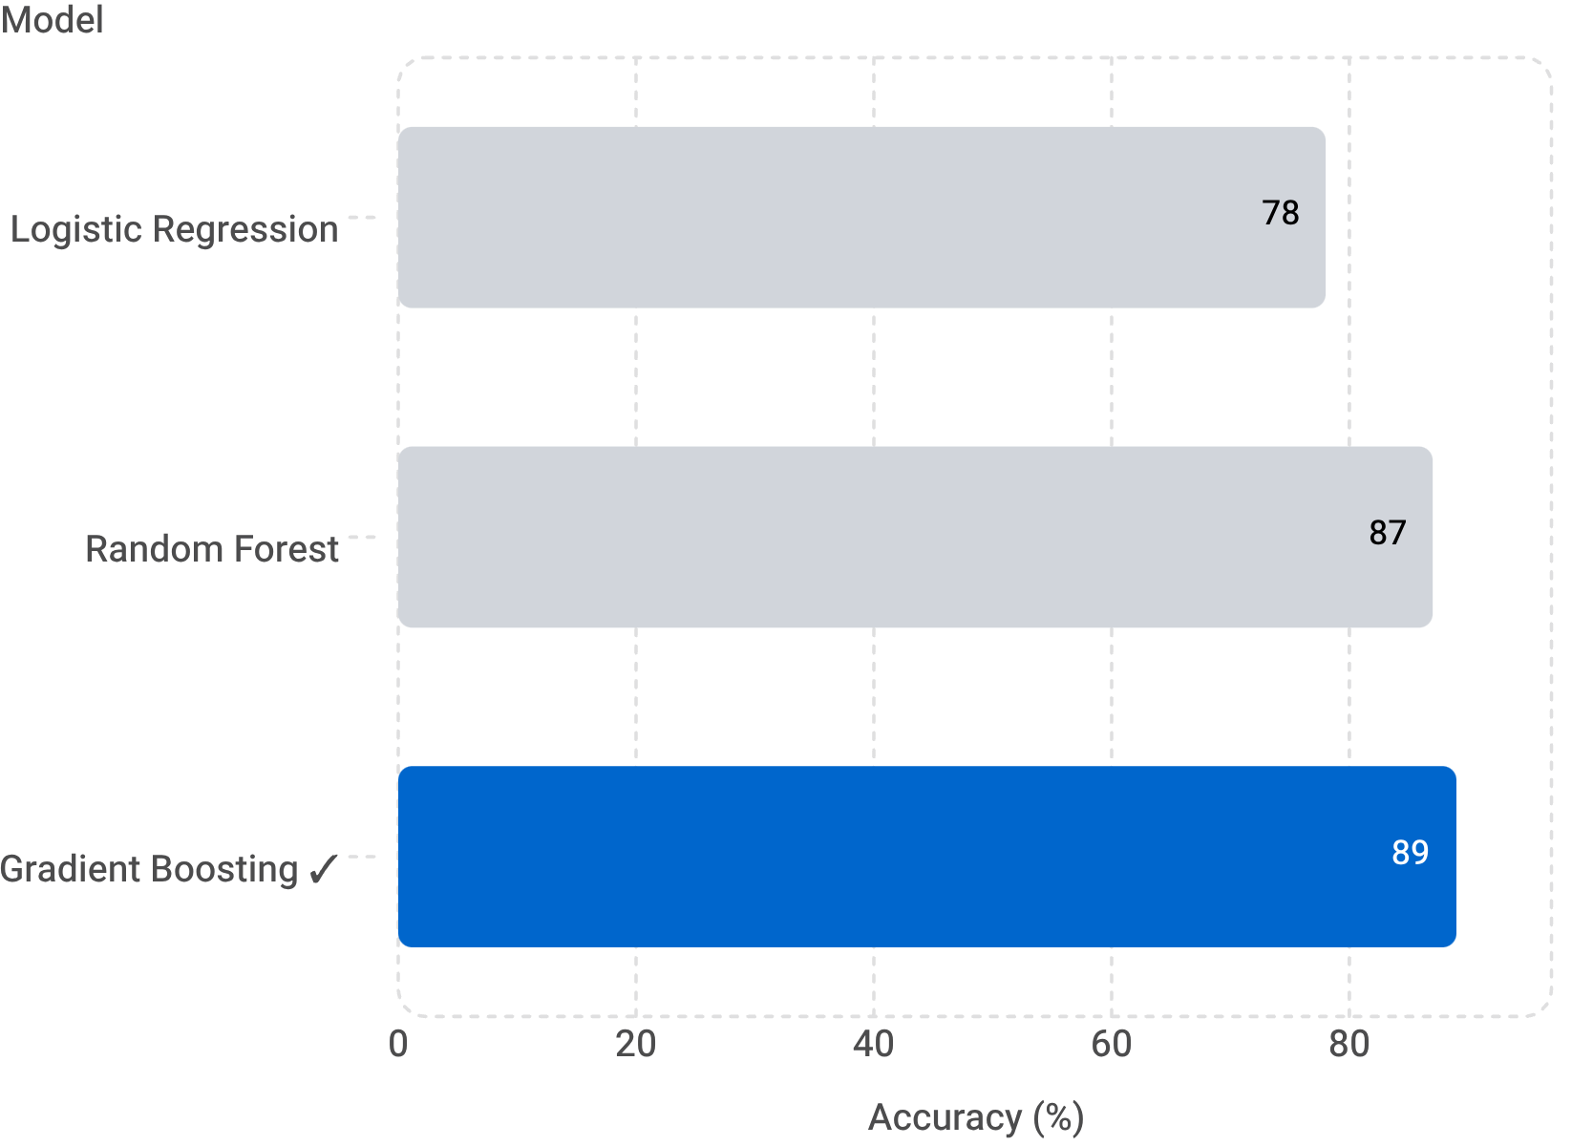

MACHINE LEARNING
ML Classification Model
Three classification algorithms were benchmarked against the same training/test split to select the optimal model for provider utilization prediction. Gradient Boosting emerged as the clear winner across all evaluation metrics.
Model Comparison
Model Performance Detail
Target Variable
Input Features
Provider Utilization Level: Low / Medium / High, derived from service frequency and total payment volume thresholds
Provider type, state, HCPCS service code, beneficiary count, submitted charges, and historical utilization patterns
Cross-Validation
Class Accuracy
5-fold CV confirms model stability: ±2% variance across folds — no signs of overfitting or class imbalance degradation
Low Utilization: 94% | Medium: 89% | High: 85% — performance degrades gracefully at higher complexity classes
Gradient Boosting outperforms Logistic Regression by 11 percentage points and Random Forest by 2 points — with superior AUC-ROC of 0.91 and balanced precision/recall across all three utilization classes.

Slide 7

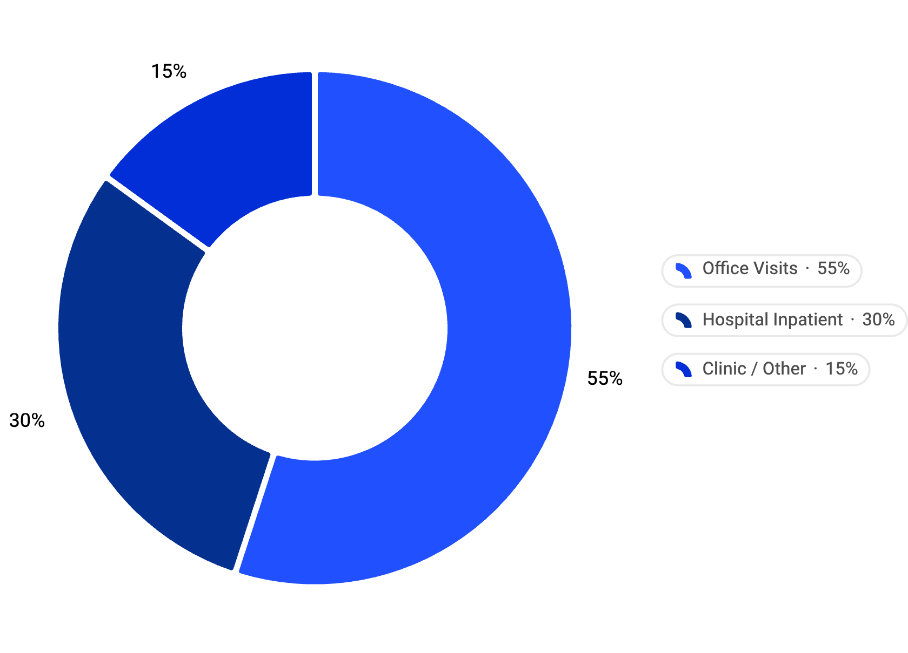
DASHBOARD 1 OF 3
Power BI Dashboard: Executive Overview
The Executive Overview dashboard provides C-suite and senior leadership with a single-pane view of Medicare program performance — surfacing KPIs, geographic patterns, and trend signals across the full provider network.
12,540
895K
Total Providers
Services Rendered
Active in current period
Total service events
350K
$78.5M
Beneficiaries
Medicare Payments
Unique lives served
Total program spend
Provider Type Breakdown — Physicians represent the largest segment (45%) but hospitals carry higher per-event payment weight.
Place of Service Distribution — The majority of services (55%) occur in office settings; hospital inpatient at 30% drives disproportionate cost.
An interactive geographic heatmap in the live Power BI dashboard allows executives to drill into state-level utilization density across all 50 states with top performers highlighted.

Slide 8
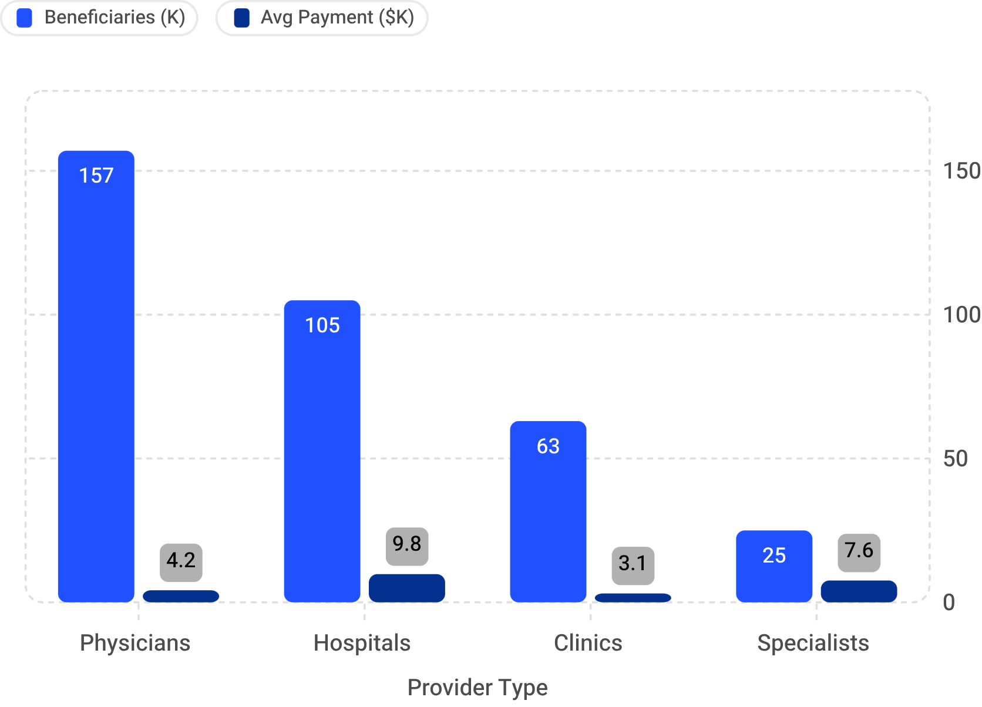
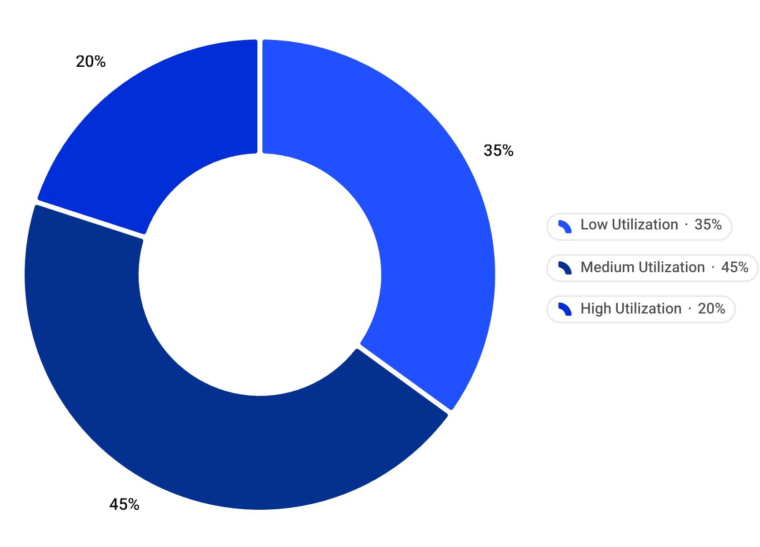
DASHBOARD 2 OF 3
Power BI Dashboard: Provider Performance
The Provider Performance dashboard enables operations and medical management teams to benchmark individual providers, assess utilization class distributions, and drill into performance by type, geography, and service category.
Hospitals serve fewer beneficiaries but carry the highest average payment per provider — a key cost concentration signal for executive attention.
The ML model classifies 20% of providers as High Utilization — these 2,508 providers represent the primary target population for cost management programs.
Top 10 Providers
Performance KPI Cards
Interactive Filters
Ranked by total service count with beneficiary impact, payment volume, and quarter-over-quarter growth indicators for each
Avg. payment per service | Avg. payment per beneficiary | Avg. payment per provider — updated with each dashboard refresh
State, provider type, and service category slicers enable dynamic drill-down — any combination produces an instant filtered view

Slide 9
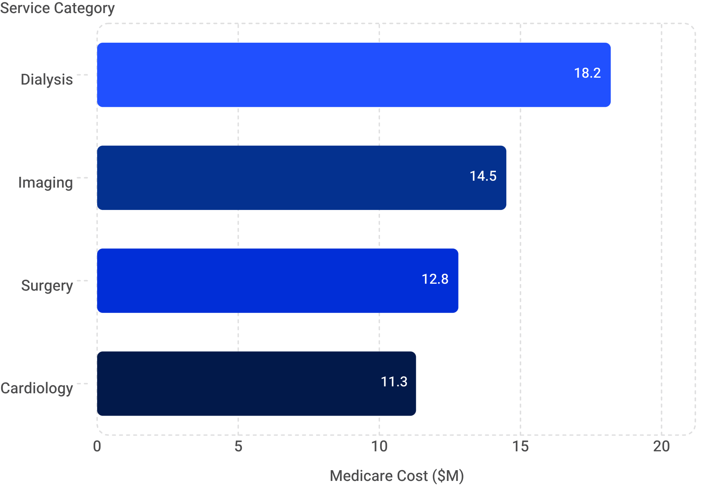
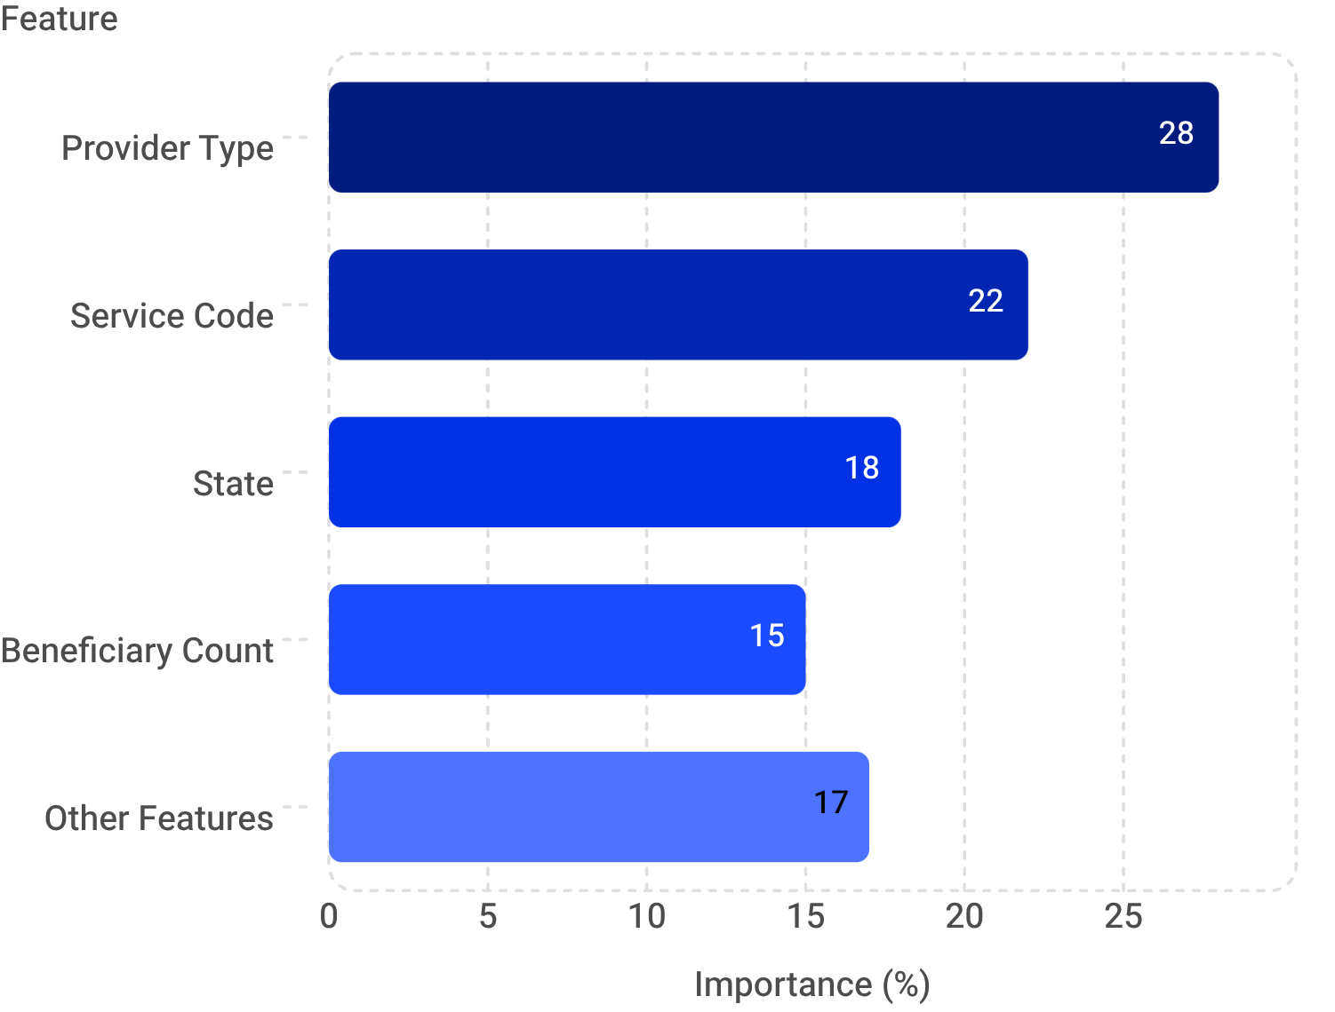
DASHBOARD 3 OF 3
Power BI Dashboard: Cost & ML Insights
The Cost & ML Insights dashboard bridges financial analytics with model outputs — exposing the highest-cost service lines, payment variance outliers, and ML prediction accuracy in a single operational view.
ML Feature Importance
Provider Type (28%) and Service Code (22%) together explain 50% of model variance — validating EDA findings and confirming the clinical logic of the Gradient Boosting model.
Dialysis alone accounts for $18.2M (23%) of total Medicare spend — the single highest-cost service category and a primary target for utilization management programs.
Payment Variance Scatter
Actual vs. Predicted
Confusion Matrix
High-Cost Outliers
Scatter plot of submitted charges vs. Medicare payments surfaces the 39% average variance and isolates outlier providers exceeding 2× the mean gap
Line chart overlaying real utilization outcomes against ML predictions confirms 89% accuracy in production validation across the test holdout set
Heatmap of Low/Med/High classification: 94% / 89% / 85% per-class accuracy — model performs strongest on Low Utilization providers
Scatter plot flags the 2% of providers driving 15% of total costs — enabling targeted outreach and case management prioritization

Slide 10

CONCLUSION
Conclusion & Business Impact
This end-to-end solution demonstrates that machine learning and Power BI, when tightly integrated, can transform raw Medicare claims data into a continuous, actionable intelligence system for healthcare executives and operations teams.
End-to-End Solution
Scalability & Next Steps
Integrated ML pipeline + three Power BI dashboards deliver a complete provider analytics system — from raw ingestion to executive-ready insight — with no manual reporting steps.
01
Monthly Retraining
Provider Classification
Model retrains automatically with each new claims batch; dashboards refresh in parallel with no manual intervention
89% accurate utilization segmentation (Low/Medium/High) enables precision targeting of the 20% of providers classified as High Utilization — the population most likely to benefit from intervention.
02
Executive Decision-Making
Predictive Alerts
Real-time dashboards surface cost drivers, performance outliers, and geographic variation — replacing static monthly reports with dynamic, self-service analytics.
Deploy threshold-based alerts for emerging high-cost providers before they breach utilization thresholds
Business Impact
03
Targeted provider management and service optimization programs enabled by this solution have the potential to reduce Medicare program costs by 5–10% — translating to $4M–$8M in savings on the current $78.5M spend base.
Provider Feedback Loops
Implement provider-facing performance reports to close the loop between analytics and care delivery behavior
04
Model Expansion
Extend classification to predict readmission risk, fraud likelihood, and quality-of-care scores using the same pipeline
The solution is production-ready and extensible — designed to scale as new data sources and business questions emerge.

